Slide 1

Paru Dahal DATA 434
Project Dashboard Functional Review

Slide 2

Dashboard Functional Overview
I have created a dashboard which retrieves data from a csv file. Based on the selected industry (from the dropdown menu), the script filters the data. It then calculates the total number of layoffs for each location within the chosen industry. Finally, it presents a line chart showing the total layoffs by location (X-axis) and the corresponding count (Y-axis).

Slide 3

Key Points from The Dashboard
Visualization: It displays a line chart to explore trends.
Filtering: Users can filter layoffs by industry using a dropdown menu.
Layout
Title: "Layoff Analysis Dashboard"
Filter: A dropdown menu allows users to select an industry (all industries are displayed by default).

Slide 4

One of the several USE Case
One of the best use case would be a recent graduate is considering careers in Marketing or Data Science. They open the dashboard and explore the "Marketing" industry. The chart reveals relatively stable layoffs compared to Data Science. This insight might lead them to prioritize marketing roles while potentially taking additional courses to bolster their data science skills for future stability.

Slide 5
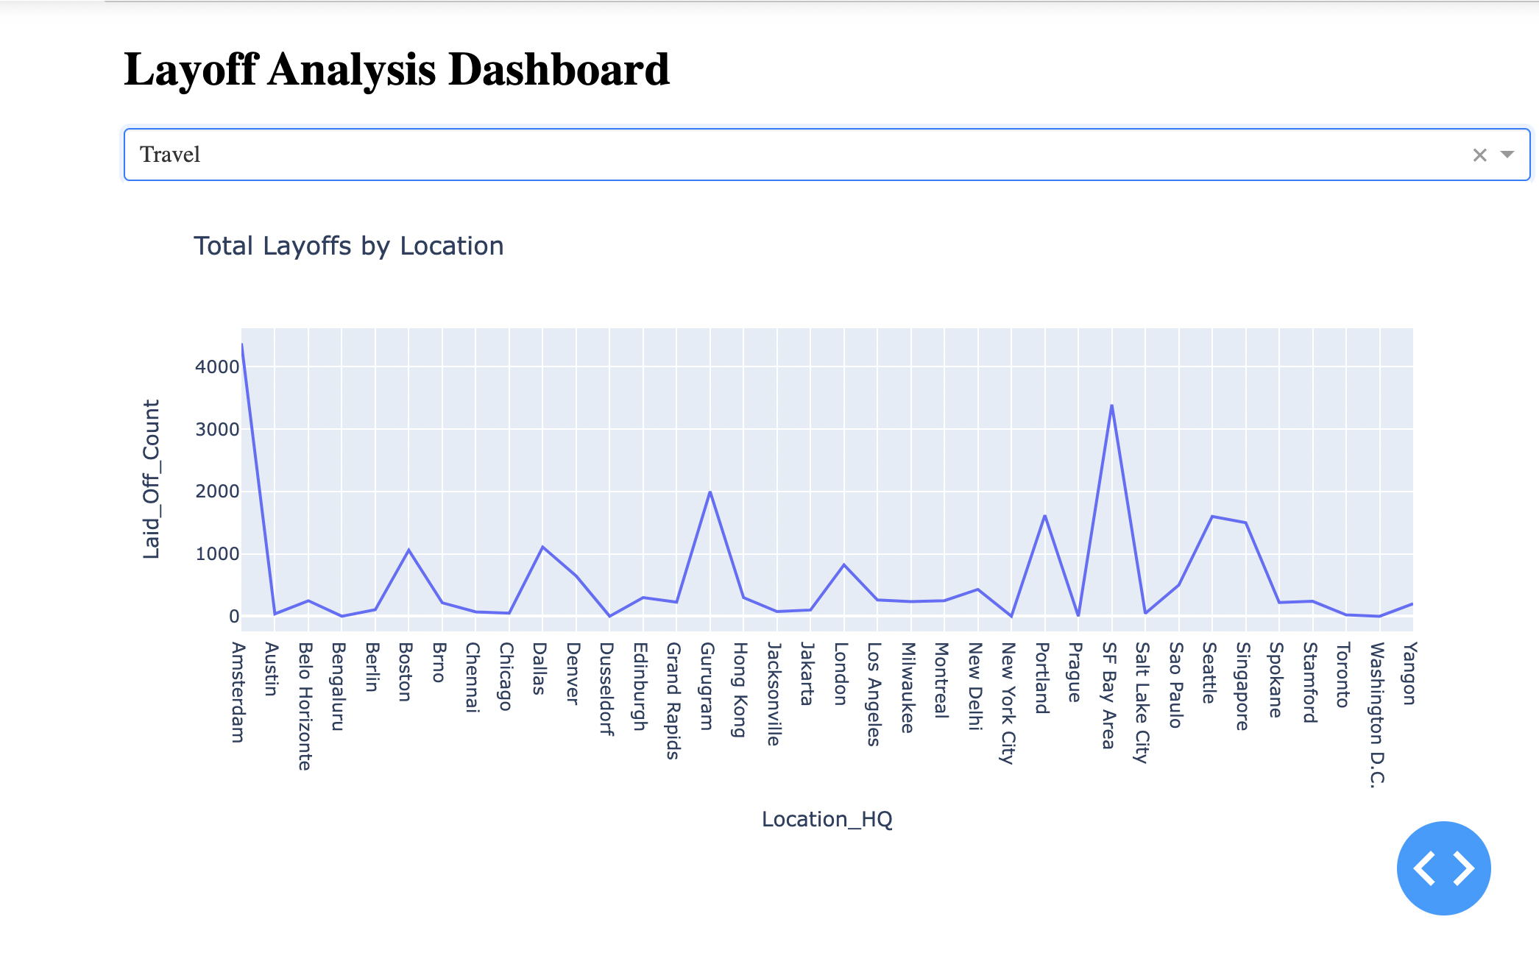
Dashboard Sample

